Slide 1


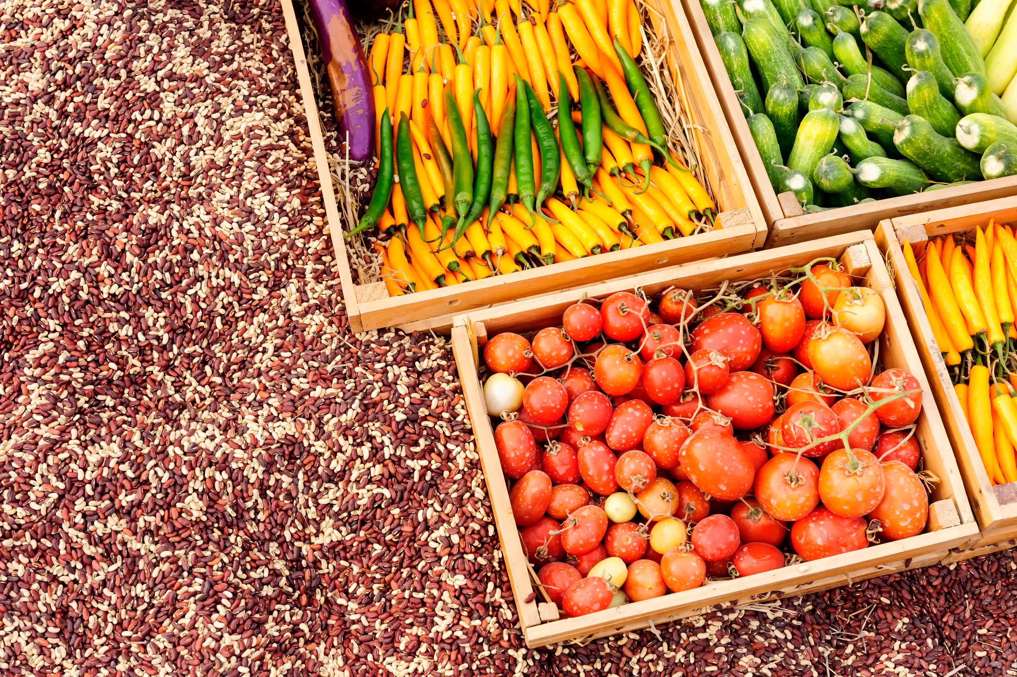
Department of Multidisciplinary Engineering
Vishwakarma Institute of Technology, Pune
A.Y.(2022-2023) SEM II
FarmAI
Yield Estimation
Kuldeep Aher 12111492
Swayamprakash Mahale 12110910
Sahil Mandhare 12110788
Divya Lothe 12111523
Shrirang Mahankaliwar 12110835
Guide: Prof. Sangeeta Kurundkar

Slide 2







EDI MSE
Contents
Introduction
Literature Review
Problem Statement
Objective of EDI Project
EDI Domain, technology and tools being used
Design- System Architecture
Methodology/Algorithm/Technique used
Executable Project Demo.
Result Discussion
Individual responsibility
Conclusion
References

Slide 3
Introduction
Agriculture is a crucial sector, and accurate yield estimation plays a vital role in making informed decisions regarding resource allocation, crop management, and overall farm profitability. The yield estimation robot is an innovative technological solution designed to revolutionize the way farmers estimate and predict crop yields.
Traditionally, yield estimation has relied on manual methods, which are time-consuming, labor-intensive, and prone to human errors. With the advent of modern technology, the yield estimation robot offers an automated and efficient approach to yield prediction

Slide 4
Literature Survey
Sr.No. | Title/Author of Paper | Features provided
1 | Yield prediction from digital image analysis: A technique with potential for vineyard assessments prior to harvest- Gregory M. Dunn | This paper tested the potential of analyzing digital images to differentiate between fruit and other elements in Cabernet Sauvignon canopies, and found that the ratio of 'fruit' pixels to total image pixels explained 85% of the variation in yield. Implications for future development of automated and spatially aware methods to predict vineyard yield. Their results show that digital image analysis can provide a useful measure of the amount of fruit present on grapevines at harvest and we conclude that automated yield prediction based on analysis of digital images of grapevine canopies is technically feasible.
2 | Crop Yield Prediction Using Image Processing- S G Shiva Prasad Yadav | In this paper, the proposed system of yield estimation is divided into two phases: GUI development and image acquisition. Charge-coupled device (CCD) is used to capture images of tree fruits, image processing is performed to modify the image, and image segmentation is used to separate input images into areas that strongly relate to objects or areas of interest. The implementation of crop yield detection involves finding the co-ordinates of edge pixels, calculating the mean of pixels, and calculating the center of clusters.
3 | Recognition of Bloom/Yield in Crop Images Using Deep | The proposed technique uses k-means segmentation on orange tree images to minimize shadow effects and extract oranges using blob detection and size calculation. The object separation step is used to separate overlapping fruit, reduce undesired edges, and segment the object in the image using a particular RGB value. Results show that manually counting and marking all the orange fruit in all the input images produces a ground truth.
Sr.No. | Title/Author of Paper | Features provided
1 | Yield prediction from digital image analysis: A technique with potential for vineyard assessments prior to harvest- Gregory M. Dunn | This paper tested the potential of analysing digital images to differentiate between fruit and other elements in Cabernet Sauvignon canopies, and found that the ratio of 'fruit' pixels to total image pixels explained 85% of the variation in yield. Implications for future development of automated and spatially aware methods to predict vineyard yield. Their results show that digital image analysis can provide a useful measure of the amount of fruit present on grapevines at harvest and we conclude that automated yield prediction based on analysis of digital images of grapevine canopies is technically feasible.
2 | Crop Yield Prediction Using Image Processing- S G Shiva Prasad Yadav | In this paper, the proposed system of yield estimation is divided into two phases: GUI development and image acquisition. Charge-coupled device (CCD) is used to capture image of tree fruits, image processing is performed to modify the image, and image segmentation is used to separate input images into areas that have strong relation with objects or areas of interest. The implementation of crop yield detection involves finding the co-ordinates of edge pixels, calculating the mean of pixels, and calculating the centre of clusters. The acquired image is pre-processed for size adjustment and converted in HSV format. The program then uploads all the counted fruits data to firebase cloud for future reference.
3 | Recognition of Bloom/Yield in Crop Images Using Deep Learning Models for Smart Agriculture: A Review- Bini Darwin | The proposed technique uses k-means segmentation on orange tree images to minimize shadow effects and extract oranges using blob detection and size calculation. The object separation step is used to separate overlapping fruit, reduce undesired edges, and segment the object in the image using a particular RGB value. Results show that manually counting and marking all the orange fruit in all the input images produces a ground truth.

Slide 5
Literature Survey
Sr.No. | Title/Author of Paper | Features provided
4 | A Survey of Computer Vision Methods for Counting Fruits and Yield Prediction- Anisha Syal | This paper reviews various methods of yield estimation and prediction; According to the research, researchers have developed an automatic system for rapid and better yield estimation for various agricultural crops, using computer vision, digital image processing, and pre-processing algorithms. However, the average yield measurement error is 31.4%. This paper reflects on the drawbacks in current yield calculation systems, these include lack of accurate data, cost, etc.
5 | Research on Rice Yield Prediction Model Based on Deep Learning-Xiao Han | The research on rice is an important part of agricultural production and practice in China, where the average planting area, yield per unit area, and total yield of rice rank second in the national grain crop. There is an urgent need to study a new method of accurate rice yield estimation in order to alleviate the problem of food shortage. Convolutional neural networks are used in deep learning to reduce the number of parameters and improve generalization ability through local perception and weight-sharing. They use deconvolution to restore the size of feature maps and can realize pixel-level segmentation of the image, solving the problem of segmentation.
6 | Early Yield Prediction Using Image Analysis of Apple/Fruit and Tree Canopy Features with Neural Networks-Hong Cheng | The majority of studies have used image processing algorithms to estimate total fruit number and fruit diameters to achieve yield prediction. The small differences between the early and late yield prediction model mentioned in this paper could be attributed to the fact that the proposed method with the neural network, based on the features from canopy images, can reduce the adverse influence from foliage. Hence, the method could be used for yield prediction in early and late growing periods after June drop, even when the apple fruit are small and green.
Sr.No. | Title/Author of Paper | Features provided
1 | Yield prediction from digital image analysis: A technique with potential for vineyard assessments prior to harvest- Gregory M. Dunn | This paper tested the potential of analysing digital images to differentiate between fruit and other elements in Cabernet Sauvignon canopies, and found that the ratio of 'fruit' pixels to total image pixels explained 85% of the variation in yield. Implications for future development of automated and spatially aware methods to predict vineyard yield. Their results show that digital image analysis can provide a useful measure of the amount of fruit present on grapevines at harvest and we conclude that automated yield prediction based on analysis of digital images of grapevine canopies is technically feasible.
2 | Crop Yield Prediction Using Image Processing- S G Shiva Prasad Yadav | In this paper, the proposed system of yield estimation is divided into two phases: GUI development and image acquisition. Charge-coupled device (CCD) is used to capture image of tree fruits, image processing is performed to modify the image, and image segmentation is used to separate input images into areas that have strong relation with objects or areas of interest. The implementation of crop yield detection involves finding the co-ordinates of edge pixels, calculating the mean of pixels, and calculating the centre of clusters. The acquired image is pre-processed for size adjustment and converted in HSV format. The program then uploads all the counted fruits data to firebase cloud for future reference.
3 | Recognition of Bloom/Yield in Crop Images Using Deep Learning Models for Smart Agriculture: A Review- Bini Darwin | The proposed technique uses k-means segmentation on orange tree images to minimize shadow effects and extract oranges using blob detection and size calculation. The object separation step is used to separate overlapping fruit, reduce undesired edges, and segment the object in the image using a particular RGB value. Results show that manually counting and marking all the orange fruit in all the input images produces a ground truth.

Slide 6
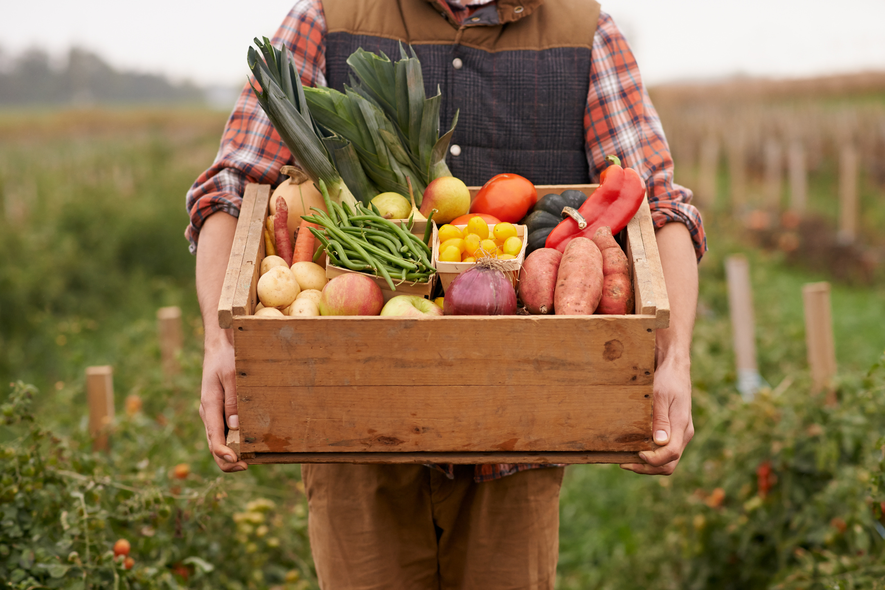


Problem
Statement
Traditional methods of predicting crop yields are often inaccurate and time-consuming. Yield calculation robots aim to provide a more precise and efficient method of predicting crop yields.
The data collected can be used to generate accurate predictions of crop yields and identify potential issues early on, allowing farmers to take necessary actions to optimize their crop management strategies.

Slide 7


Objective
The objective of the yield estimation robot is to provide accurate and real-time estimations of crop yields in order to assist farmers in making informed decisions and optimizing their agricultural practices.
The yield estimation robot aims to serve as a decision support system for farmers. By providing real-time and accurate yield estimations.
The objective of yield estimation robots is to accurately and efficiently estimate the yield of crops in agricultural fields. These robots use various technologies such as sensors, cameras, and artificial intelligence algorithms to collect data on plant growth, health, and other variables.

Slide 8








Technology
Used
Domain - Agri Tech

Slide 9
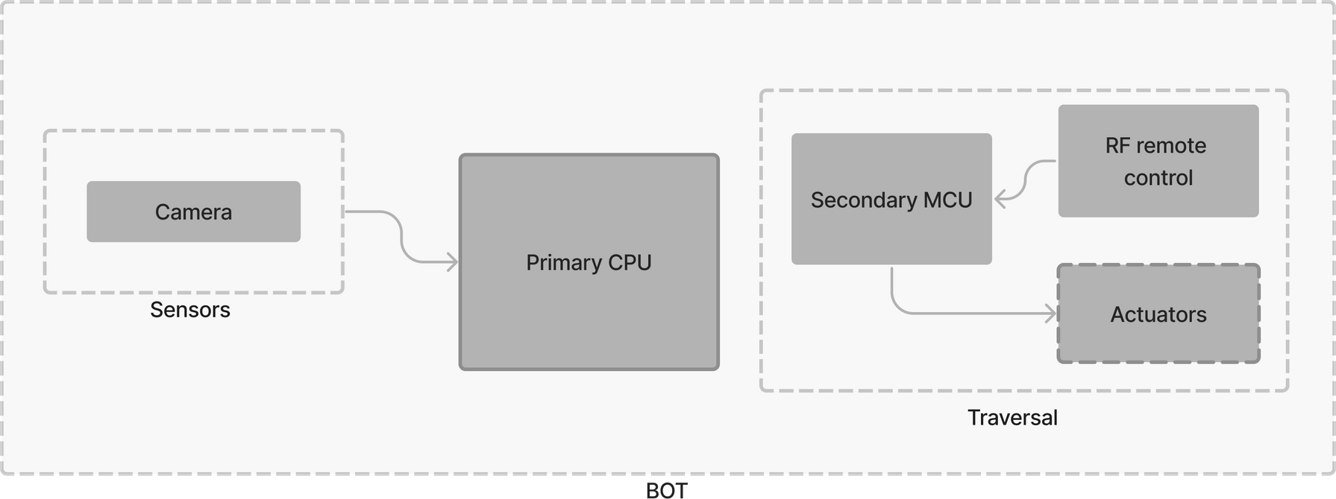
System
Architecture

Slide 10
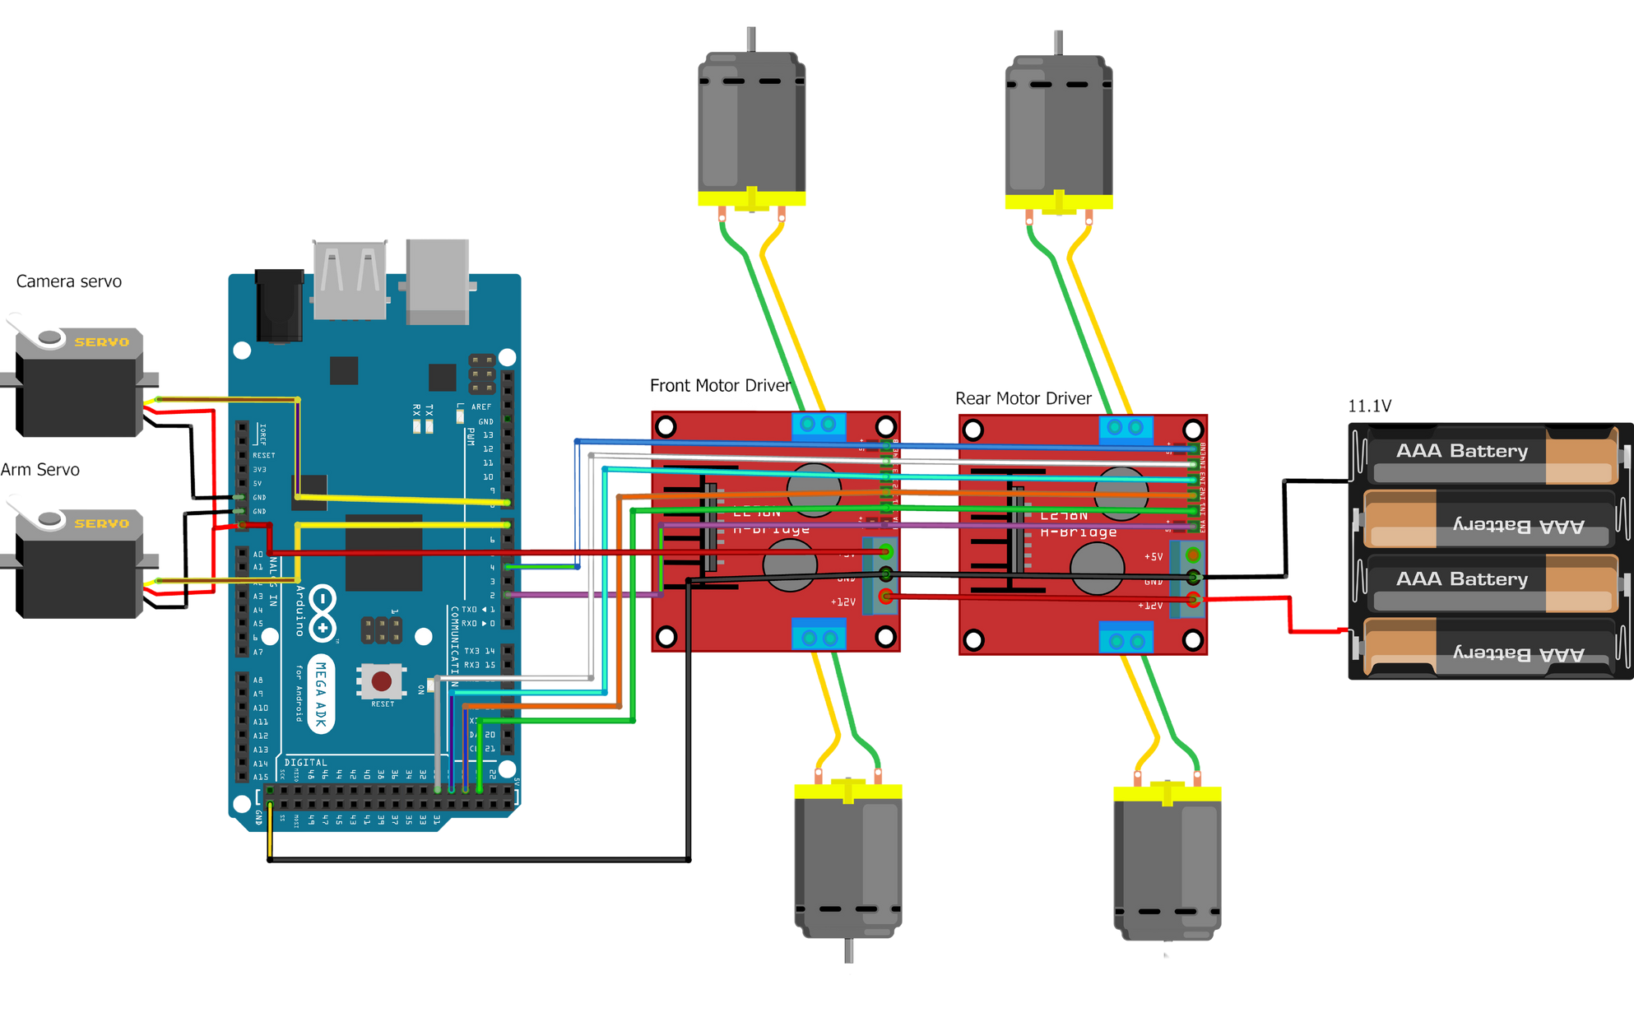
Circuit
Diagram

Slide 11
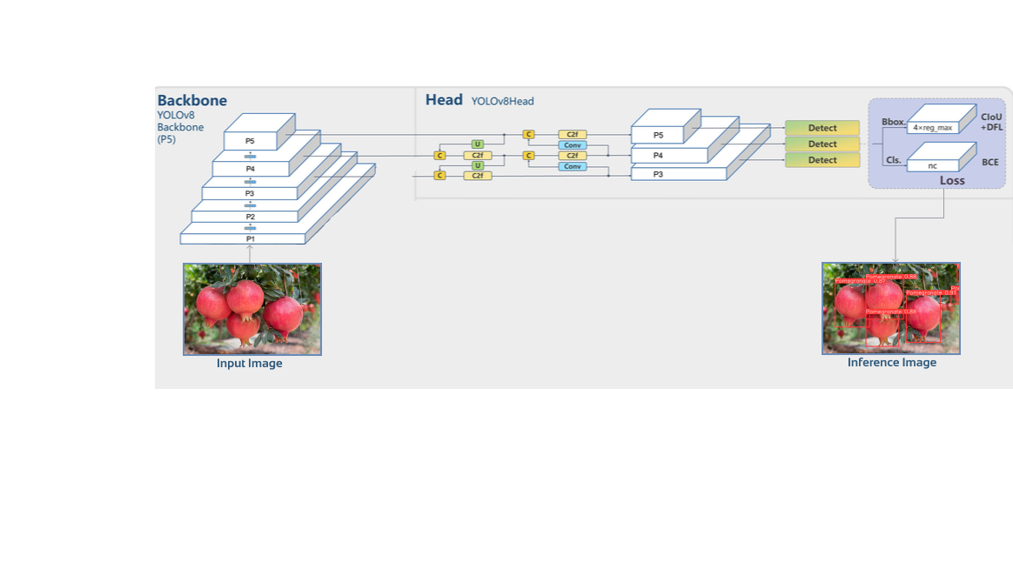
Yolo v8
Architecture

Slide 12
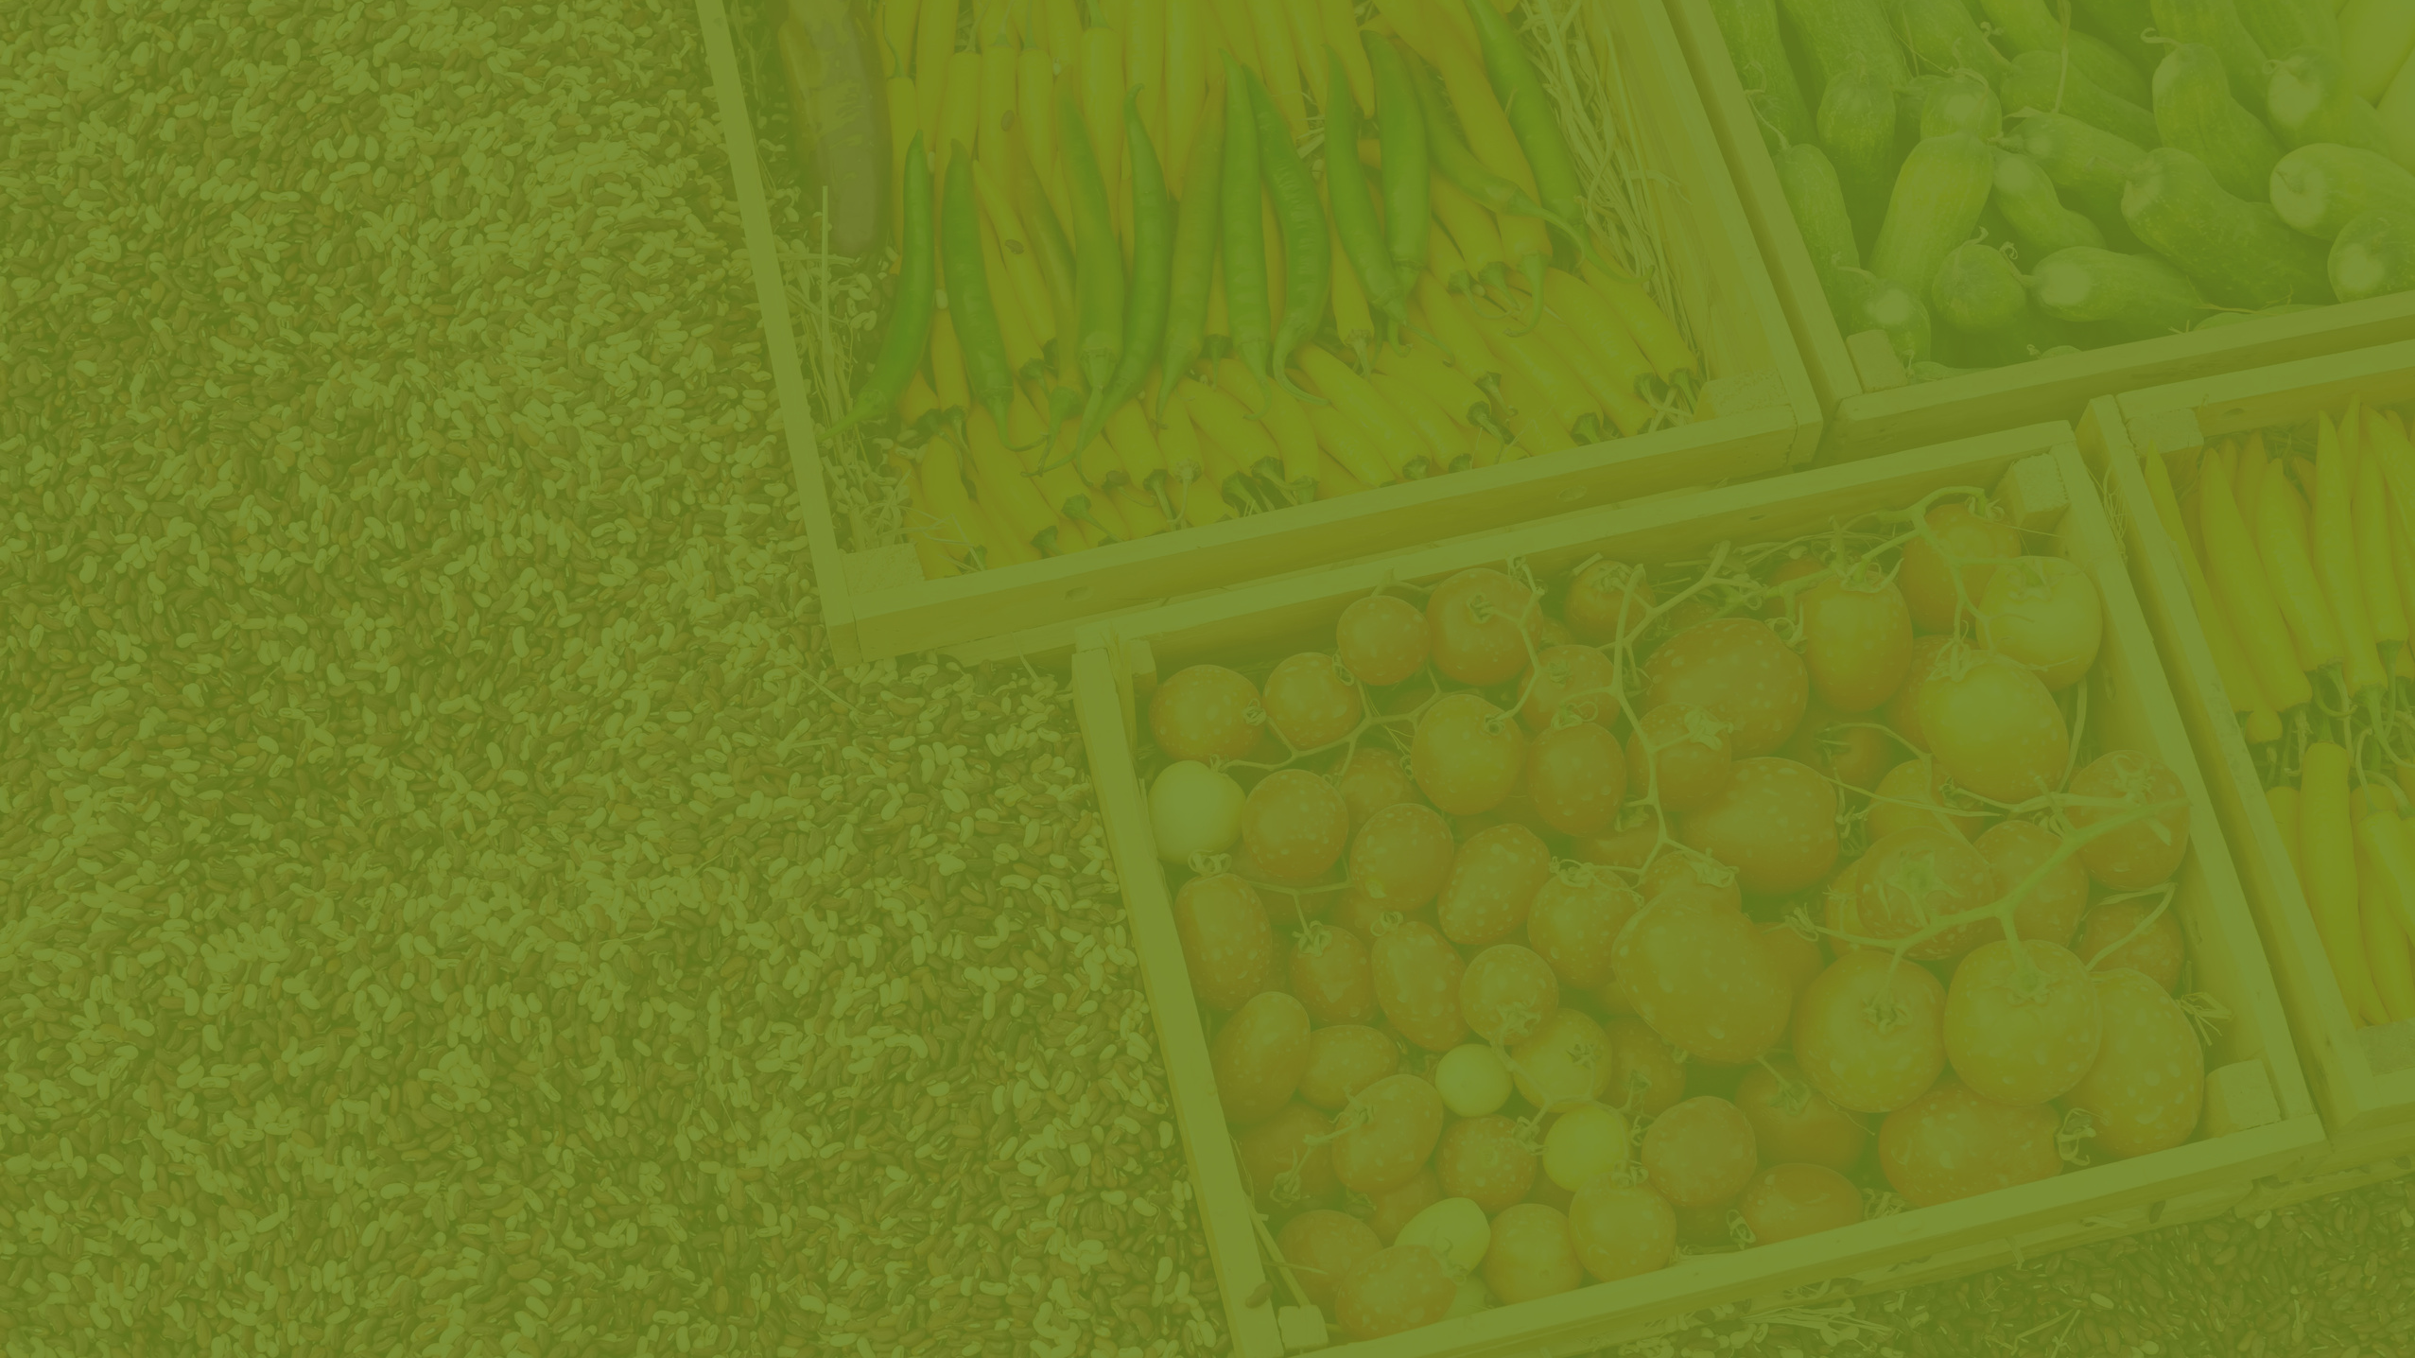
Algorithms Used
RC Control: State Machine Algorithm
Fruit detection: Yolo v8
Fruit tracking: BoT Sort

Slide 13
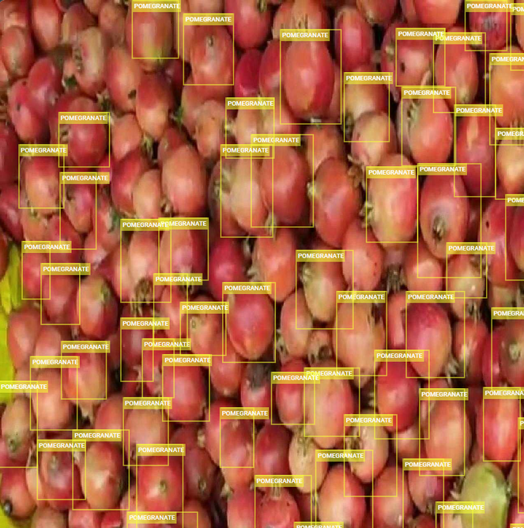
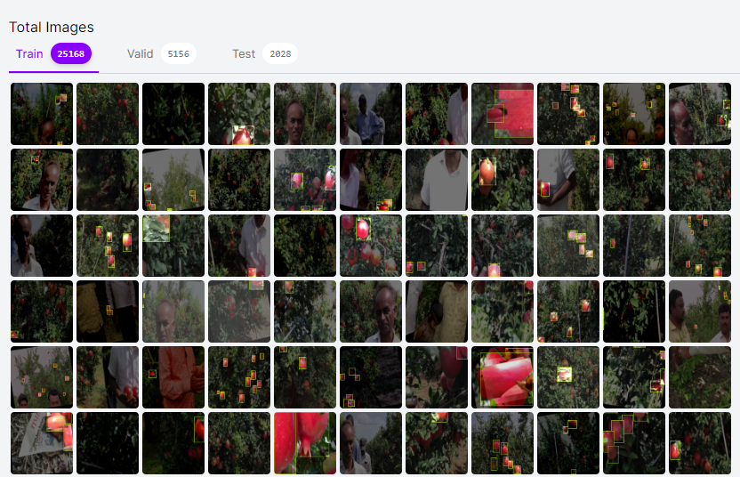
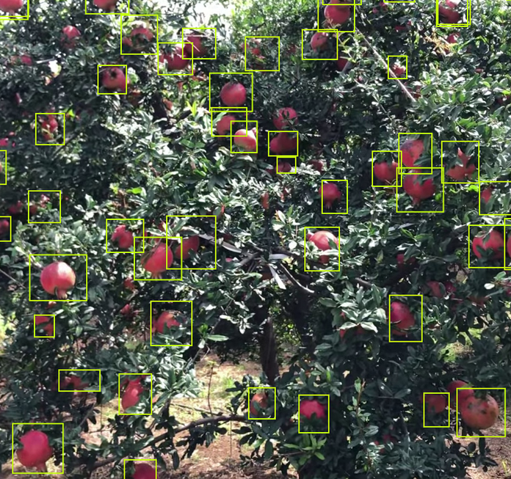
Dataset
Annotated images

Slide 14
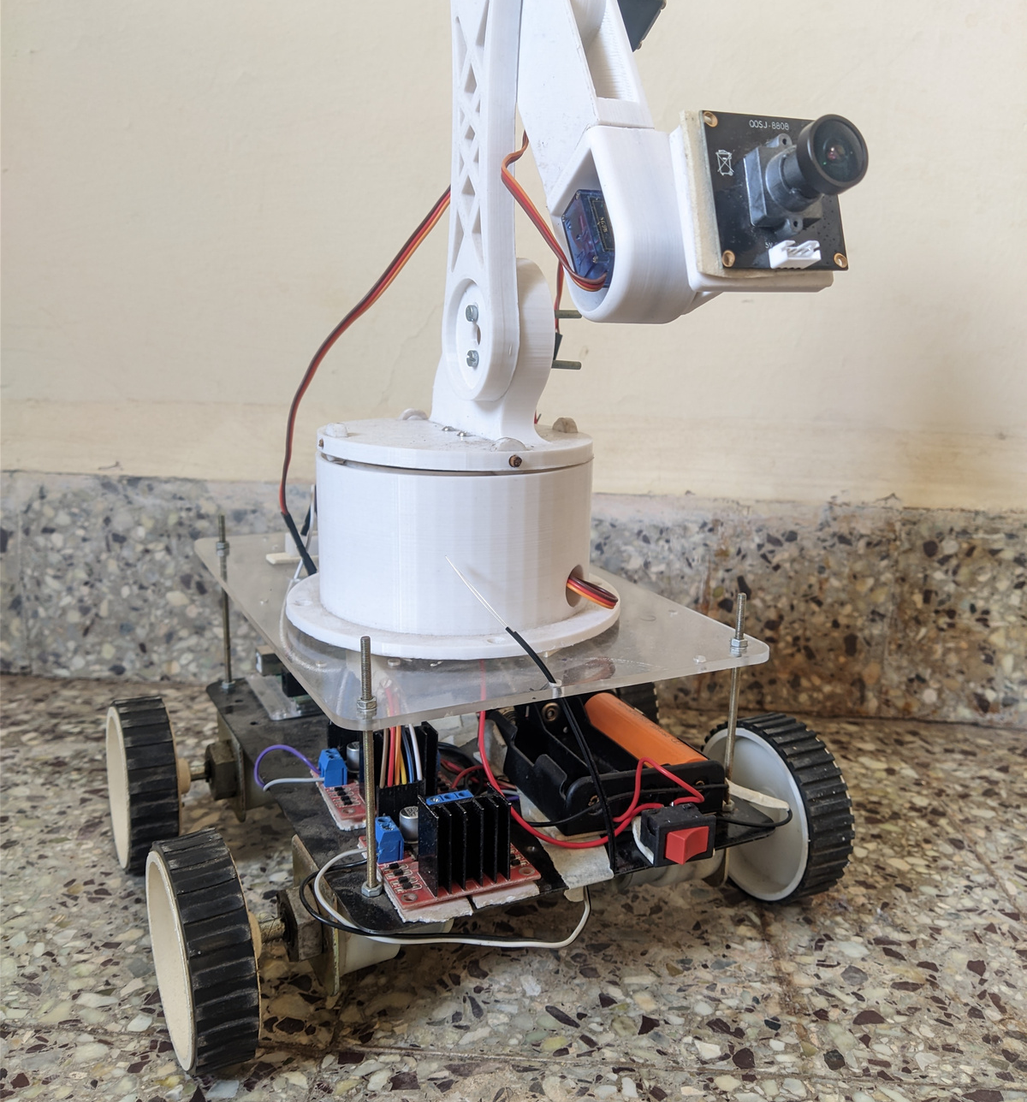
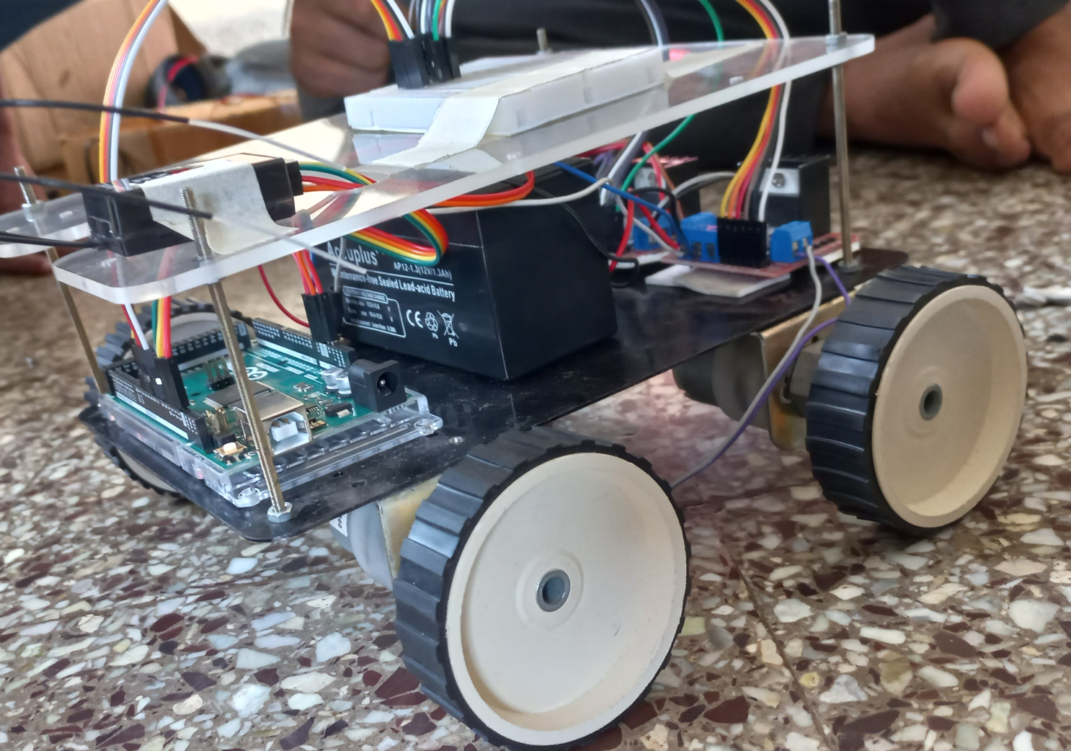
Hardware
MSE
ESE
Prototype bot with Remote control

Slide 15
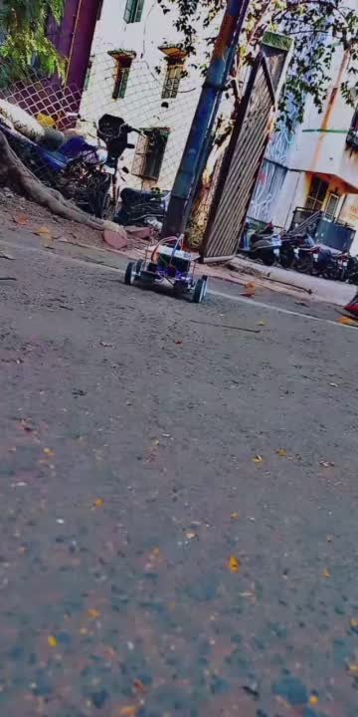

Slide 16
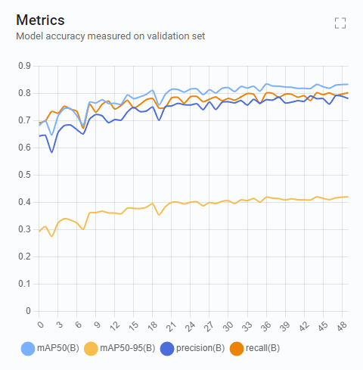
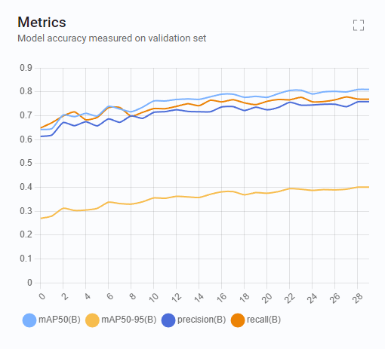
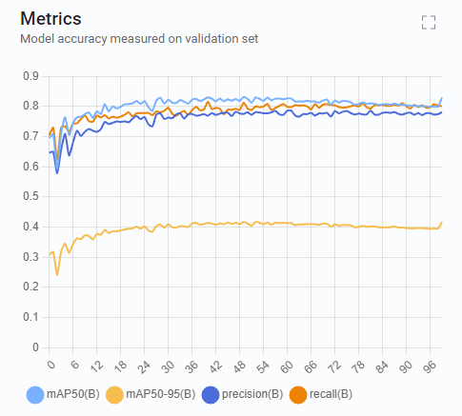
Results
mAP = 40
epochs =30
pretrained weight = yolov8l
mAP = 42.8
epochs =50
pretrained weight = yolov8s
mAP = 43.2
epochs =100
pretrained weight = yolov8m

Slide 17

EDI MSE
Business Model
Suggesting vendors near the farm location
Subscription Model
Continuous Improvement and Innovation
Partnerships and Integrations
Monthly or Annual Subscriptions

Slide 18
Individual responsibility
Kuldeep : Model Training and Testing, RC control testing, Dataset Collection
Divya : Dataset Augmentation, Hardware Assembly, Image Annotations
Swayamprakash : Python GuI, Bot Control Algorithm, Image Annotation
Shrirang : Model Training, Hardware Assembly, Image Annotations
Sahil : Python GuI , Arm Control Algorithm, Image Annotations

Slide 19



Thank You
For Your Attention

